Slide 1
UNIT 4
THE LEGISLATIVE BRANCH

Slide 2
THE STRUCTURE OF CONGRESS
Chapter 5

Slide 3
CONGRESSIONAL MEMBERSHIP
Chapter 5 Section 1

Slide 4
What is the structure and organization of Congress?

Slide 5
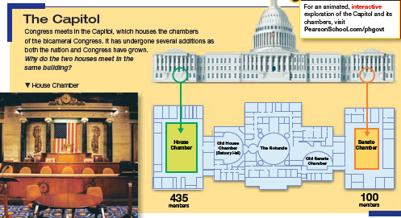
A Bicameral Congress
The Constitution establishes a bicameral legislature – that is, a legislature made up of two houses.

Slide 6
A Bicameral Congress
The Founding Fathers created a bicameral legislature for three reasons: historical, practical, theoretical.
REASON | SUMMARY
Historical | Americans familiar with bicameral British Parliament
Practical | Compromise between the New Jersey and Virginia Plans
Theoretical | Each house can check power of the other; prevents Congress from becoming too powerful.

Slide 7
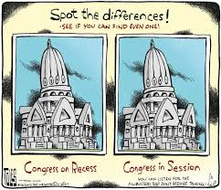
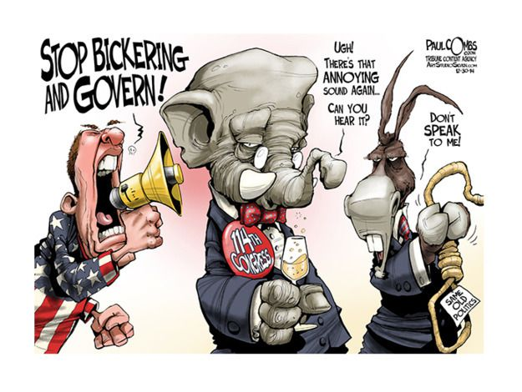
Terms and Sessions
Terms of Congress
Session of Congress
Each term of Congress lasts two years
The start of each two year term starts on January 3rd on every odd-numbered year.
A session of Congress is that period of time during which, each year, Congress assembles
There are two sessions of each term of Congress – one session each year.
Special Session – only the President may call; emergency situations only.

Slide 8
The House of Representatives

Slide 9
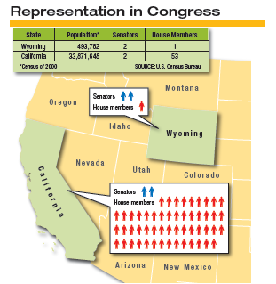
Size and Terms of HOR
Exact size = 435 members
  Represents a district within the state
The total number of seats in the HOR is apportioned (distributed) among the States based on their population.
There is no limit on how many terms a representative can serve.
Representatives serve for two-year terms

Slide 10
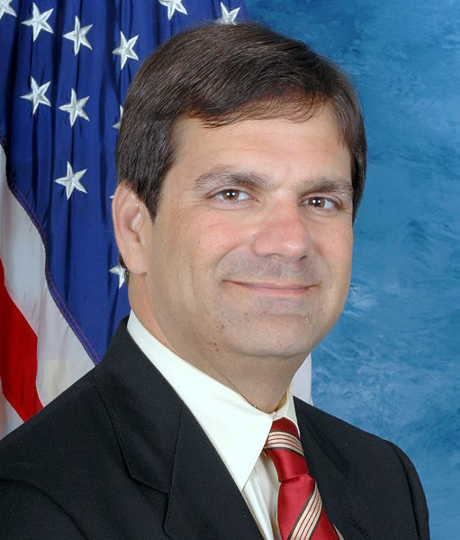
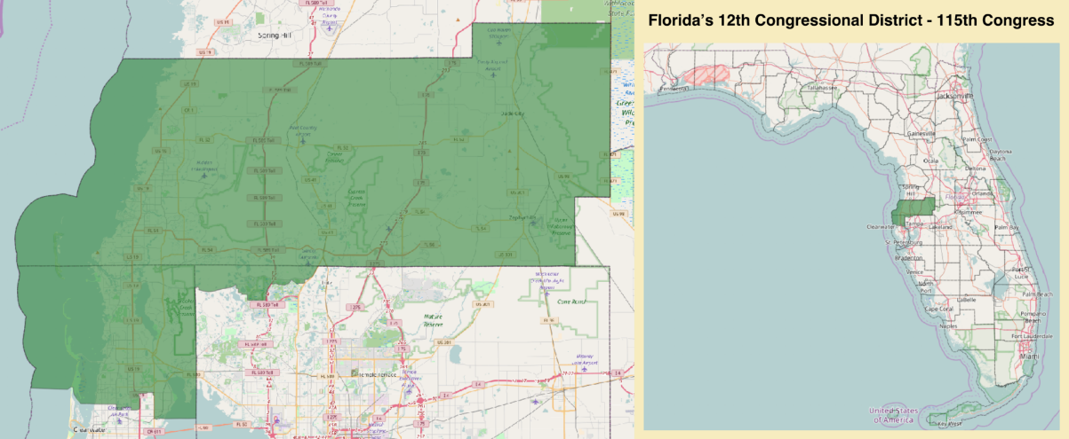
Representative from Florida –District 12
Gus Bilirakis
Name : Gus Bilirakis
Party : R
State : Florida
District : 12
In Office : 2006 - Present
Education : BA University of Florida, 1986; JD Stetson University, 1989
Previous Political Experience : FL House, 1998-2006
Previous Occupation : Attorney
Election Status : In office

Slide 11
Reapportionment
Article I of the Constitution directs Congress to reapportion (distribute) the seats in the House every ten years, after each census.
Reapportionment Act of 1929
Permanent size of House = 435
Census Bureau determines number of seats in each State
The Bureau sends plan to President
Becomes effective 60 days after both Houses receiving plan and don’t reject it

Slide 12
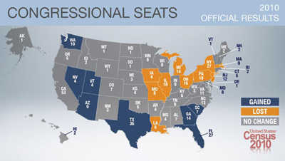

Slide 13
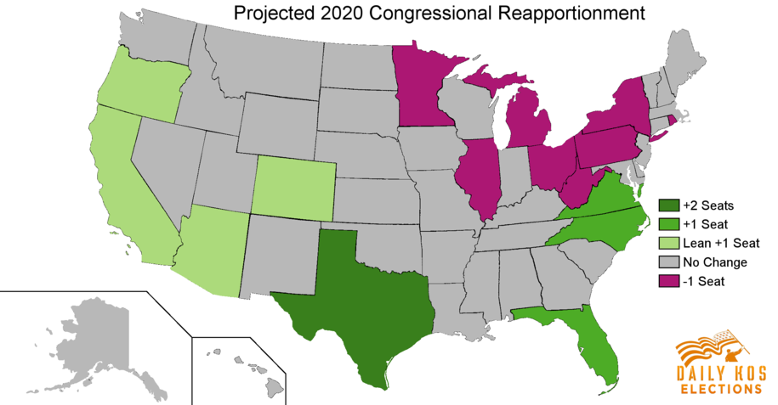
2020 Projections

Slide 14
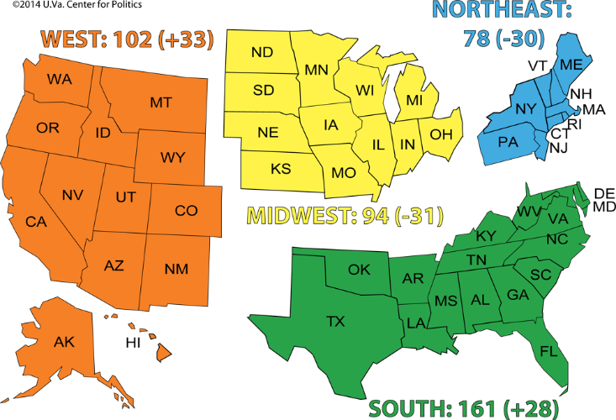
Congressional Districts Since 1960

Slide 15
Congressional Elections
Date | Congressional elections are held on the Tuesday following the first Monday in November of each even-numbered year.
Off – Year Elections | Congressional elections that occur in nonpresidential years – between presidential elections Example: 2014 and 2018
Districts | The 435 members of the House are chosen by 435 separate congressional districts across the country.
Gerrymandering | Districts that have been drawn to the advantage of the political party that controls the State’s legislature.

Slide 16
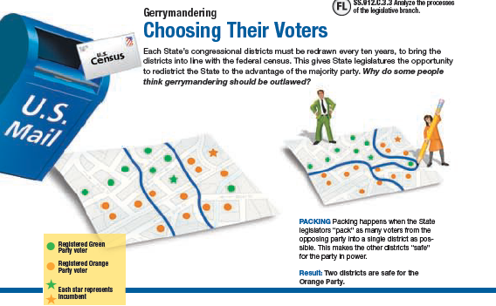

Slide 17
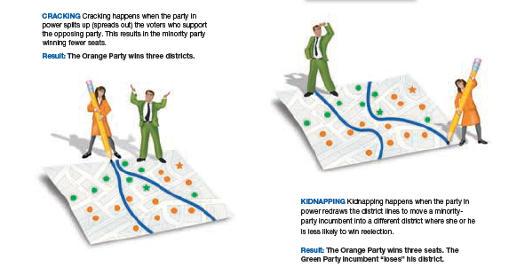

Slide 18
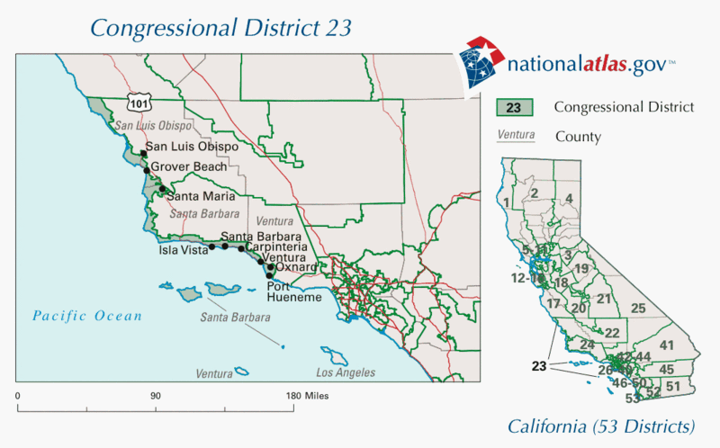

Slide 19
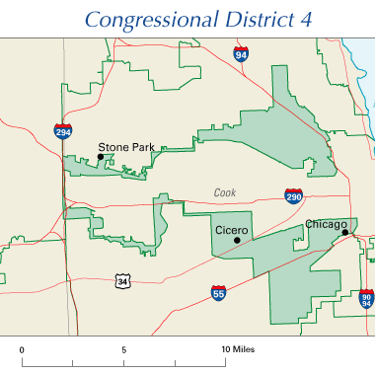

Slide 20
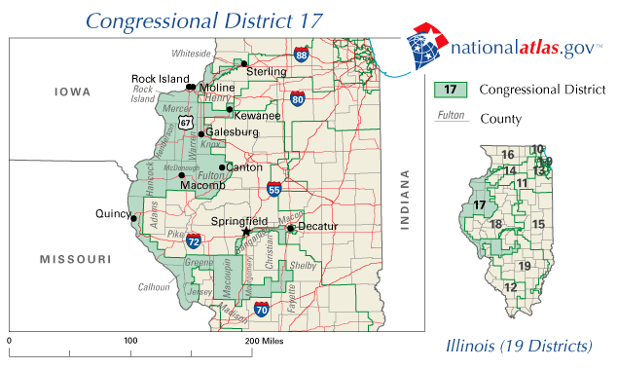

Slide 21
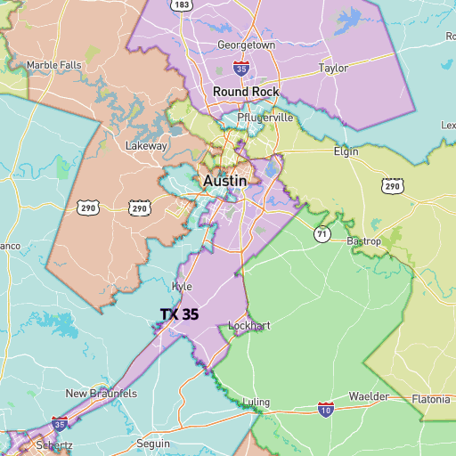

Slide 22
CHAPTER 5 POWER-POINT ACTIVITY
-Copy down the following chart:
-You will need to create 10 districts in this state that has a population of 4 “people”
-If you are a female you will represent the Republican Party (R), if you are a male you will represent the Democratic Party (D)
-Your job is to create as many districts as possible for your political party. On the bottom of the page, explain which technique of gerrymandering you used to create your districts and how many districts your political party would win, and how many they would lose
R | D | D | D | R | R | D | R | R | D
R | R | R | D | R | R | R | D | D | R
R | D | R | D | D | R | R | R | R | D
D | R | R | R | D | R | R | R | D | R

Slide 23
Qualification for Office – House
FORMAL QUALIFICATIONS
AGE | Must be at least 25 years of age
CITIZEN | Must be a citizen of the US for at least seven years
RESIDENT | Must be an inhabitant of the State from which they are elected

Slide 24
The Senate

Slide 25
Size, Election, and Terms
100 Senators
  2 from each state
  Based upon equal representation
  Represents an entire states
Elections are held on the Tuesday following the first Monday in November of each even-numbered year
Senators serve for six-year terms
  Terms are staggered; only 1/3 of the Senate expire of two years, allowing for a continuous body in the Senate

Slide 26
Qualification for Office - Senate
FORMAL QUALIFICATIONS
AGE | Must be at least 30 years of age
CITIZEN | Must be a citizen of the US for at least nine years
RESIDENT | Must be an inhabitant of the State from which they are elected

Slide 27
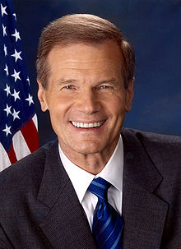
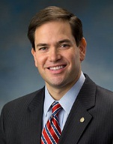
Senators from Florida
Bill Nelson - Democrat
Marco Rubio - Republican
Assumed office
January 3, 2001
Assumed office
January 3, 2011

Slide 28
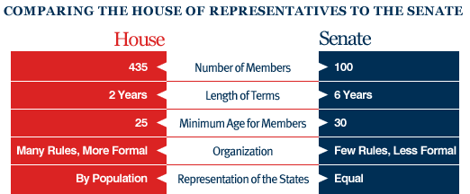
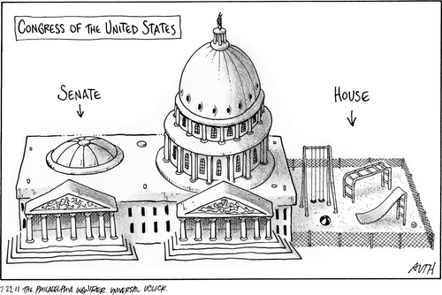

Slide 29
HOUSE OF REPRESENTATIVES
Chapter 5 Section 2

Slide 30

House Leadership
The Speaker of the House
  The presiding officer and its most powerful leader
  Presiding over the sessions of the House, the Speaker can influence proceedings by deciding which members to recognize first
  The Speaker also appoints the members of some committees, schedules bills for action, and refers bills to the proper committees
Paul Ryan

Slide 31




House Leadership
Majority Leader | -The Speaker’s top assistant (from the same party) -Helps plan the party’s legislative program, steer important bills through the House, and make sure that committees finish the work on bills important to the party | Kevin McCarthy
Minority Leader | -The leader of the party in the House not in power -Critique the majority party’s bills and keeps his or her own party united | Nancy Pelosi
Majority Whip | -To watch and to persuade party members to vote as the party wishes | Steve Scalise
Minority Whip | -To watch and to persuade party members to vote as the party wishes | Steny Hoyer

Slide 32
SENATE
Chapter 5 Section 3

Slide 33
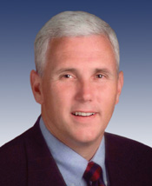
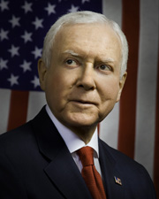
Senate Leadership
The Vice President
President Pro Tempore
The Constitution names the vice president as the Senate’s president, but they don’t have the same role as the Speaker of the House
The vice president may recognize members and put questions to a vote, but they may only vote in the event of a tie
Mike Pence
Since the vice president spends most of his/her time to executive duties, the senate selects a leader from the majority party.
This person is in “charge” when the vice president is not in the senate
Orrin Hatch

Slide 34
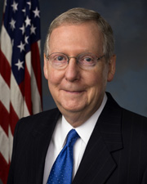
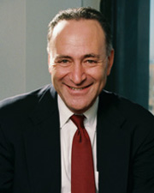
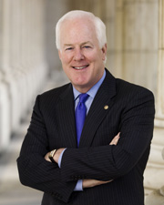

Senate Leadership
Majority Leader | -Helps plan the party’s legislative program, steer important bills through the House, and make sure that committees finish the work on bills important to the party | Mitch McConnell
Minority Leader | -The leader of the party in the Senate not in power -Critique the majority party’s bills and keeps his or her own party united | Charles Schumer
Majority Whip | -To watch and to persuade party members to vote as the party wishes | John Coryn
Minority Whip | -To watch and to persuade party members to vote as the party wishes | Richard Durbin

Slide 35
CONGRESSIONAL COMMITTEES
Chapter 5 Section 4

Slide 36
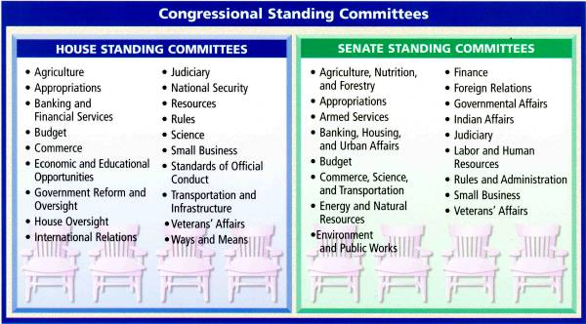
Standing Committees
Standing Committees
  Permanent committees in Congress
  Bills receive thorough consideration in standing committees; where the fate of a bill is usually decided.
Subcommittees
  Nearly all standing committees have several subcommittees that specialize in a subcategory of its standing committee’s responsibility

Slide 37
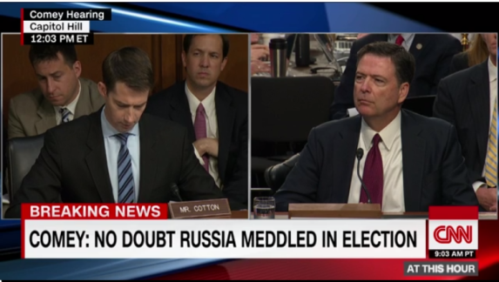
Select, Joint and Conference Committees
Select Committee
Joint and Conference Committee
Committees set up for some specific purpose; for a limited time
Investigates an essential function of the lawmaking process
  Example: Possible Obstruction of Justice
Composed of members from both houses
Joint Committee
  Issue periodic reports to the House and Senate
    Example: Joint Committee on taxation
Conference Committee
  Temporary – joint body to iron out the differences in a bill

Slide 38
Choosing Committee Members
Assignment to Committees
Role of the Committee Chair
Assignment to the “right” committee can help a member of Congress in two ways:
  First, it can increase their chance at reelection because it puts them in position to act on bills that are important to their constituents
  Second, membership on some committees can mean the lawmaker will be able to influence national policies
Members of Congress will serve on multiple committees
Along with the other leadership positions, chairpersons of standing committees are the most powerful people in Congress
They make key decisions about the work of their committees, such as when the group will meet, which bills they will consider, for how long they will meet, and deciding when hearings will be held and which witnesses will be called to testify
They also manage floor debates that take place on the bills that come from their committees.

Slide 39
CHAPTER 5 REVIEW QUESTIONS
WHAT IS THE DIFFERENCE BETWEEN REDISTRICTING AND REAPPORTIONMENT?
WHY DO WE HAVE A BICAMERAL LEGISLATURE?
WHAT IS THE DIFFERENCE BETWEEN A TERM AND A SESSION?
NAME THREE WAYS THAT THE HOUSE AND SENATE DIFFER.
WHY DO THE HOUSE AND SENATE ORGANIZE THEMSELVES INTO COMMITTEES?
WHAT IS THE ROLE OF A CONFERENCE COMMITTEE?
WHAT PURPOSE DO STANDING COMMITTEES SERVE?
HOW ARE MEMBERS OF CONGRESS ASSIGNED TO COMMITTEES?

Slide 40
CONSTITUTIONAL POWERS
Chapter 6

Slide 41
How have the powers of Congress changed over time?

Slide 42
The Delegated Powers
Congress has only those powers delegated (granted, given) to it by the Constitution. Congress delegates those powers in three different ways:
Expressed Powers | -Actually written into the Constitution. -Article I, Section 8, Clauses 1-17 -Example: Commerce power
Implied Powers | -Powers are not stated in the Constitution but drawn from the expressed powers. -Article 1, Section 8, Clause 18 -Necessary and Proper Clause “Elastic Clause”
Inherent Powers | Powers are those that belong to all sovereign nations – for example, the power to control a nation’s border

Slide 43
Commerce Power – Expressed power
Commerce Power – the power of Congress to regulate interstate and foreign trade (this is as vital to the welfare of the nation as is the taxing power)
Limits on the use of the Commerce Power (4)
Cannot tax exports
Cannot favor the ports of one State over those of any other in the regulation of trade
Cannot require that “Vessels bound to, or from, one State be obliged to enter, clear or pay Duties in another”
Could not interfere with slave trade
This limit has been dead for almost two centuries

Slide 44
The Power to Tax – Expressed Power
Taxes – Charge levied by the government on persons or property to raise money to meet public needs.
Limits on the Taxing Power (4)
Congress may tax only for public purposes, not for private benefit
Congress may not tax exports
Direct taxes must be apportioned among the States, according to their populations
Direct tax – one that must be paid directly to the government by the person on whom it is imposed (a tax on ownership of land or buildings)
  Income tax is a direct tax, but it may be laid without regard to population
Indirect tax – one first paid by one person and then passed on to another, tax then is indirectly paid by the second person
  Indirect taxes levied by the Federal Government must be levied at the same rate in every part of the country (Examples: taxes on gasoline, alcoholic beverages, tobacco products)

Slide 45
The Borrowing Power – Expressed power
The Borrowing Power – there are no constitutional limits on the amount of money that Congress may borrow, and no restriction on the purposes for which the borrowing can be done
Deficit financing – the government has practiced this for decades. The government takes in more than it does each year and borrows to make up the difference
Public Debt – all the money borrowed by the government over the years and not yet repaid, plus the accumulated interest on the money www.brillig.com/debt_clock/

Slide 46
The Bankruptcy Power
The Currency Power
Bankruptcy Power –gives Congress the power to establish uniform laws on the subject of bankruptcies throughout the United States.
Bankruptcy – legal proceedings in which the bankrupt’s assets – however much or little they may be – are distributed among those whom a debt is owed
The States and the National Government have concurrent power to regulate bankruptcy
Currency Power – gives Congress the power to coin money and regulate the value.
The Bank of the United States (1791) – was given the power to issue bank notes, or paper money
Legal tender – any kind of money that a creditor must by law accept in payments of debt. Congress did not create a national paper currency and make it legal tender until 1861

Slide 47
Congress and Foreign Policy
Foreign Relations Power
Congress shares power in this field with the President, who is primarily responsible for the conduct of our relations with other nations
Congress has he power to approve treaties, declare war, to create and maintain an army and navy, to make rules governing land and naval forces, and to regulate foreign commerce

Slide 48
War Powers
War Powers – eight of the expressed powers given to Congress in Article I, Section 8 deal with war and national defense. Congress also shares this power with the chief executive. The Constitution makes the President the commander-in-chief of the nation’s armed forces, and, as such, the President dominates the field.
Only Congress may declare war
Has the power to raise and support armies, to provide and maintain a navy, and to make rules pertaining to the governing of land and naval forces
Congress also has the power to provide for “calling forth the militia” and for organizing, arming, and discipline of it.
Congress has the power to grant letters of marquee and reprisal and to make rules concerning captures on land and water

Slide 49
Domestic Powers
Copyrights and Patents
The Postal Powers
Copyrights and Patents – gives Congress the power to promote the progress of Science and useful Arts, by securing for limited Times to Authors and Inventors the exclusive Rights to their respective Writings and Discoveries
A Copyright is the exclusive right of an author to reproduce, publish, and sell his/her creative work
A patent grants a person the sole right to manufacture, use, or sell “any new and useful art, machine, manufacture, or composition of matter, or any new and useful improvement thereof”
A patent is good for up to twenty year
Give Congress the power to establish Post Offices and post Roads. Post roads are all postal routes, including railroads, airways, and waters within the United States, during the time that mail is being carried on them.

Slide 50
Territories and Other Areas
Power Over Territories and Other Areas – gives Congress the power to acquire, manage, and dispose of various federal areas. That power relates to the District of Columbia and the several territories including Puerto Rico, Guam, and the US Virgin Islands. It also covers hundreds of military and naval installations, arsenals, dockyards, post offices, prisons, parks, and forest preserves.
The Federal Government may acquire property by purchase or gift.
It may also acquire land through eminent domain, the inherent power to take private property for public use

Slide 51
Weights and Measures
Weights and Measures – give Congress the power to “fix the Standard of Weights and Measures” throughout the United States.
English system of pound, ounce, mile, foot, gallon, quart, etc…

Slide 52
Naturalization
Judicial Powers
Gives Congress the exclusive power to establish an uniform Rule of Naturalization.
Judicial Powers – expressed powers to create all of the federal courts below the Supreme Court and to structure the federal judiciary.
Congress also has the power to define federal crimes and set punishment for violators of federal law. (4)
  Counterfeiting
  Piracies and felonies of the high seas
  Offenses against international law
  Treason

Slide 53
The Implied Powers

Slide 54
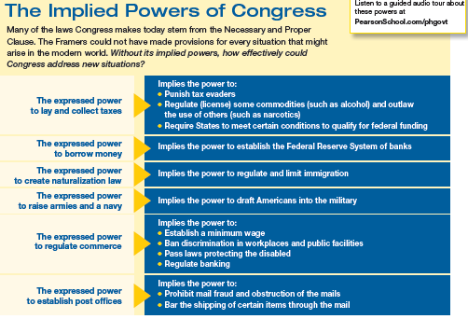

Slide 55
The Nonlegislative Powers

Slide 56
Electoral Duties
Electoral Duties – these duties given to Congress may be exercised only in very unusual circumstances
The House of Representatives may be called to elect a President
  If no candidate receives a majority of the electoral votes for President, the House of Representatives, voting by States, must decide the issue
  It must choose from among the three highest contenders in the electoral college balloting
  Each State has but one vote to cast, and a majority of the States is necessary for election
The Senate may be called to choose a Vice President
  The vote is not by States but by individual senators, with a majority of the full Senate necessary for election

Slide 57
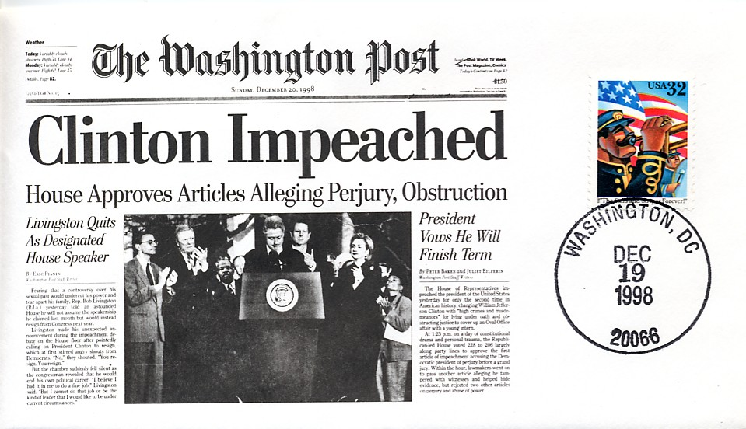
Impeachment
Impeachment – The Constitution provides that the President, Vice President, and all civil officers of the United States may “be removed from Office on Impeachment for and Conviction of, Treason, Bribery, or other high Crimes and Misdemeanors”
The House has the sole power to impeach – to accuse, bring charges
The Senate has the sole power to try – to judge, sit as a court – in impeachment cases.
Impeachment requires only a majority vote in the House; conviction requires a two-thirds vote in the Senate

Slide 58
Executive Powers
Executive Powers – The Constitution gives two executive powers to the Senate
Confirmation
  All major appointments must be confirmed by the Senate by majority vote
  Each nomination is referred to the appropriate standing committee of the Senate
  That committee may then hold hearing to decide whether or not to make a favorable recommendation to the full Senate for that appointment
  The appointment of a Cabinet officer or of some other top member of the President’s “official family” is rarely turned down by the Senate.
Ratification
The President makes treaties “by which the Advice and Consent of the Senate,…provided two thirds of the Senators present concur”
The Senate may accept or reject a treaty as it stands, or it may decide to offer amendments reservations, or understandings to it

Slide 59
The Power to Investigate
Investigatory Power
  Congress has the power to investigate any matter that falls within the scope of its legislative powers.
  Congress exercises this authority through its standing committees, and their subcommittees, and often through special committees, as well
Congress may choose to investigate for several reasons:
Gather information useful to Congress in making of some legislation
Oversee the operations of various executive branch agencies
Focus public attention on a particular subject, from the drug war to movie violence
Expose the questionable activities of public officials or private persons
Promote the particular interests of some members of Congress

Slide 60
CHAPTER 6 REVIEW QUESTIONS
Which expressed powers of Congress do you think are the most important?
What is the difference between a copyright and a patent?
Why would a member of the government be impeached?
Why is it important for Congress to have the power to investigate?

Slide 61
HOW A BILL BECOMES A LAW
Chapter 7.1

Slide 62
How does a bill become a law?

Slide 63
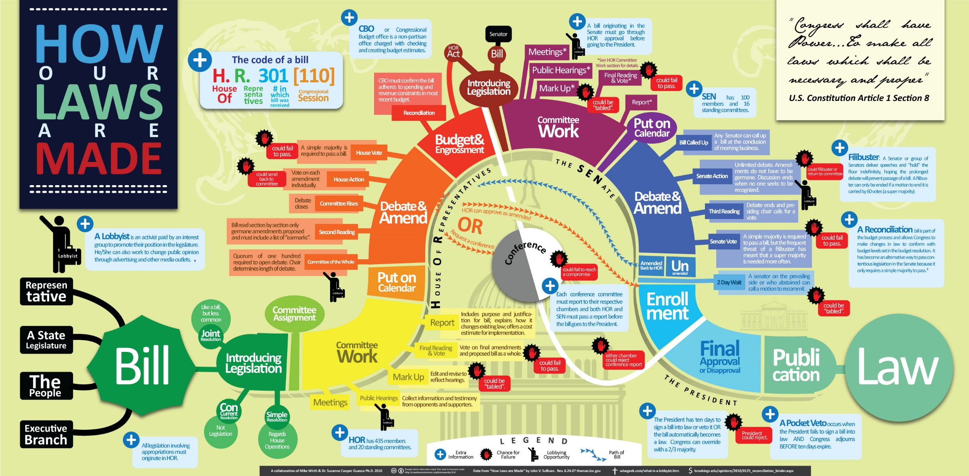

Slide 64
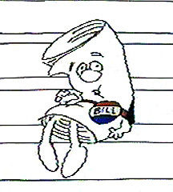
The First Steps-Step 1
A bill is a proposed law and is presented to the House or Senate for consideration.
  Ideas for bills can come from anyone, but only members of Congress can propose them
  The executive branch suggests roughly half of the bill passed
Types of Bill
Types of Resolutions
Public Bills | Apply to the nation as a whole; example tax measures
Private Bills | Apply to a certain person or places rather than to the entire nation
Joint Resolutions | Are similar to bill, when passed, have the force of law; usually deal with a temporary matter/appropriate money (Example: Presidential Inauguration, Declare War)
Concurrent Resolutions | Deal in matters in which the House and Senate must act jointly on which a law is not needed (Example: adjourning Congress or express Congress’s opinion on an issue)
Resolutions | Often called “simple resolutions” and deal with matters concerning either house alone (Example: if a new rule or procedure is needed)
Rider | A provision not likely to pass on its own and is attached to a matter that will most likely pass

Slide 65
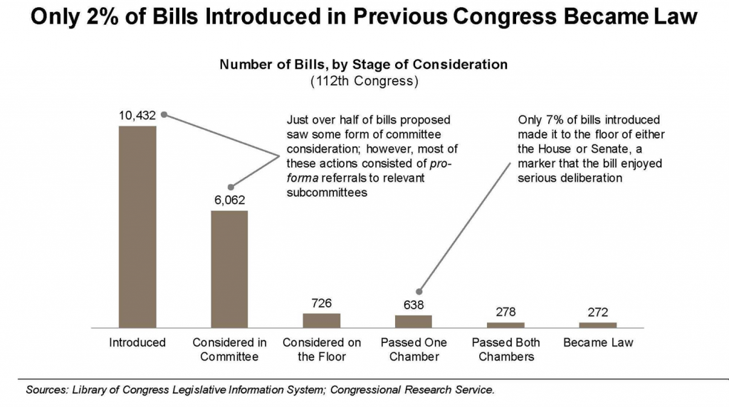

Slide 66
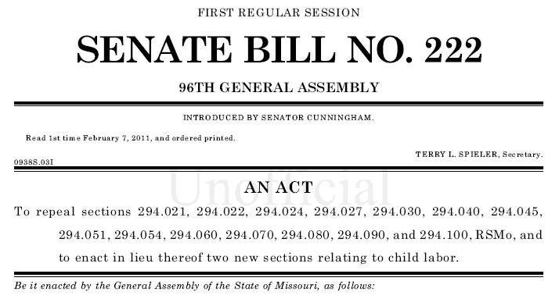
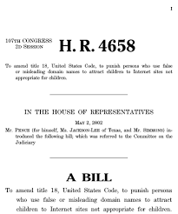
The First Steps-Step 2
  Bills are given a name
    Bills that are introduced in the House are introduced as H.R. .
    H.R. 3410 would be the 3,410 measure introduced in the House during the congressional term
    Bills that originate in the Senate receive the prefix S
    S. 210
  Resolutions are similarly identified in Congress in the order of their introduction
  In the House, members drop the bills into a hopper, a box near the clerk’s desk
  In the Senate, the presiding officer must first recognize the senator, who then formally presents the bill

Slide 67
The First Steps-Step 3
The clerk of the House also gives each bill:
  A short title
  Brief summary of its principal contents
The bill is then entered in the House Journal and in the Congressional Record for the day
The Journal
  Contains the minutes, the official record, of the daily proceedings in the House or Senate
The Congressional Record
  Account of daily proceedings

Slide 68
The Bill in Committee-Step 4
Speaker of the House send the bill to committee
  When a committee decides to act on a bill, it holds hearings to listen to expert testimony.
That body may do one of several things:
Report the bill favorably, with a “do pass” recommendation. It is then the chairman’s job to steer the bill through debate on the floor
Refuse to report the bill – “ the bill is killed” (Most bills die during this step)
Report the bill in amended form. Many bills are changed in committee, and several bills on the same subject may be combined into a single measure. This occurs in a markup session-making changes to the bill.
Report the bill with an unfavorable recommendation
Report a committee bill. This is an entirely new bill that the committee has substituted for one or several bills

Slide 69

Scheduling Floor Debates-Step 5
  The Rules Committee must grant a rule before most bills can reach the floor
    Before the measures can be taken from a calendar, the Rules Committee must approve that step and set a time for its appearance on the floor
    By not granting a rule for a bill, the Rules Committee can effectively kill it
    Certain bills are privileged
      They may be called up at almost anytime

Slide 70
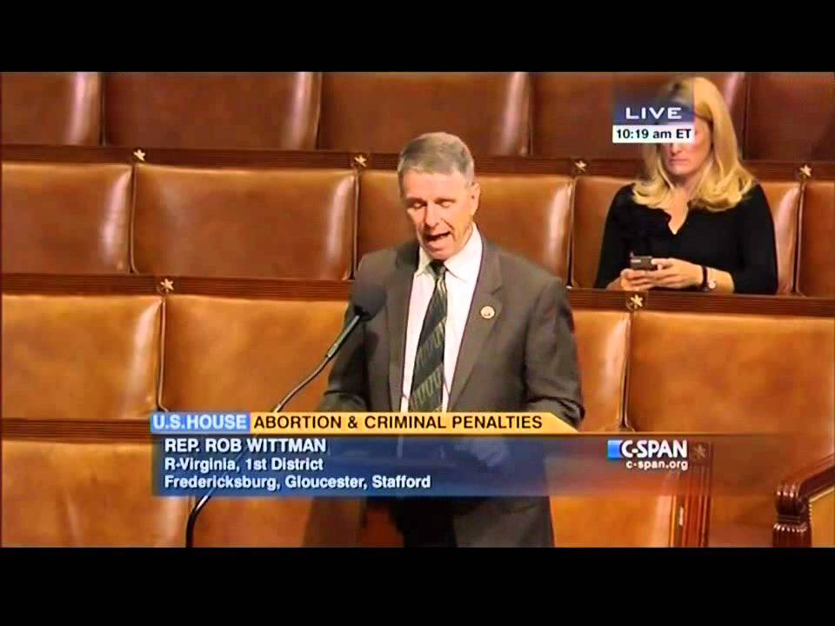
The Bill on the Floor-Step 6
  Debate on the floor
    This is where congressmen argue over the pros and cons different bills.
    At this time, amendments can be added to a bill if the majority of the members present approve them.
    Sometimes amendments are added to try to load the bill with unfavorable amendments to try and kill the bill

Slide 71
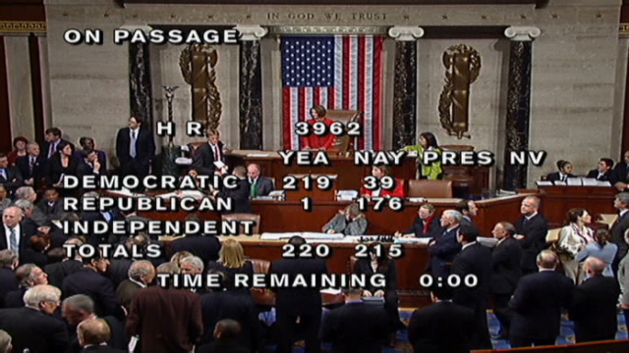
The Bill on the Floor-Step 7
  Voting
    Passage of a bill requires a majority vote of all the members present
    Voice votes are the most common
    The House also uses a third method is which votes are counted electronically
The bill is engrossed, or printed in it final form.
  The Speaker of the House signs the approved bill
Bill goes to the Senate and must pass in identical form.

Slide 72
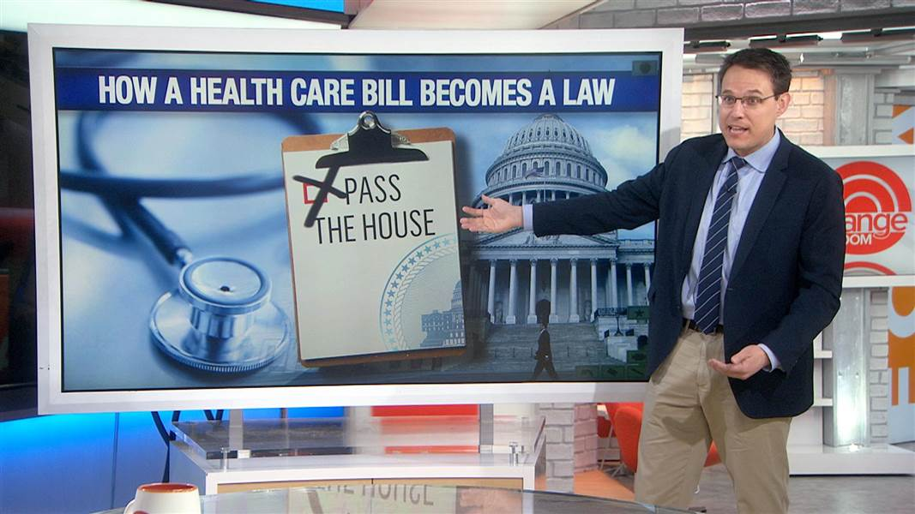

Slide 73

The Senate Floor-Step 8
Bills are called to the Senate Floor by the majority leader.
  Then the bill is sent to a standing committee
The Senate’s proceeding are less form and its rules less strict than the House

Slide 74
The Senate-Standing Committee-Step 9
Bills sent to Committee go through the same process as they do in the House
Bills can :
Report the bill favorably, with a “do pass” recommendation. It is then the chairman’s job to steer the bill through debate on the floor
Refuse to report the bill – “ the bill is killed”
Report the bill in amended form. Many bills are changed in committee, and several bills on the same subject may be combined into a single measure.
Report the bill with an unfavorable recommendation
Report a committee bill. This is an entirely new bill that the committee has substituted for one or several bills

Slide 75
Rules for Debate-Step 10
Senators may speak on the floor for as long as the please, unlike the House.
  The Senate has no rule that requires a senator to speak only to the measure before the chamber
  The Senate’s rules do not allow any member to move the previous question
  The Senate does have a “two-speech rule”
    No Senator may speak more than twice on a given question on the same legislative day

Slide 76
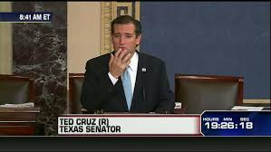
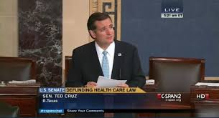
Rules for Debate
Filibuster
Attempt to talk a bill to death
  Stalling tactic
  Process in which a minority of senators seeks to delay or prevent Senate action on a measure
  Tries to monopolize the Senate floor and its time that the Senate must either drop the bill or change it in some manner acceptable to the minority
  Senator Huey Long spoke for 15 hours
    Read the phone book and gave out recipes for cornbread

Slide 77
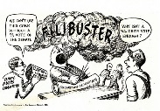
Rules for Debate
Cloture Rule
A procedure that may be used to limit or end debate in the senate. This requires 3/5th or 60 senators.
Senators hesitate to support cloture motions for two reasons
  Their dedication to the Senate’s tradition of free debate
  Their practical worry that the frequent use of cloture will undercut the value of the filibuster that they may want to use one day

Slide 78
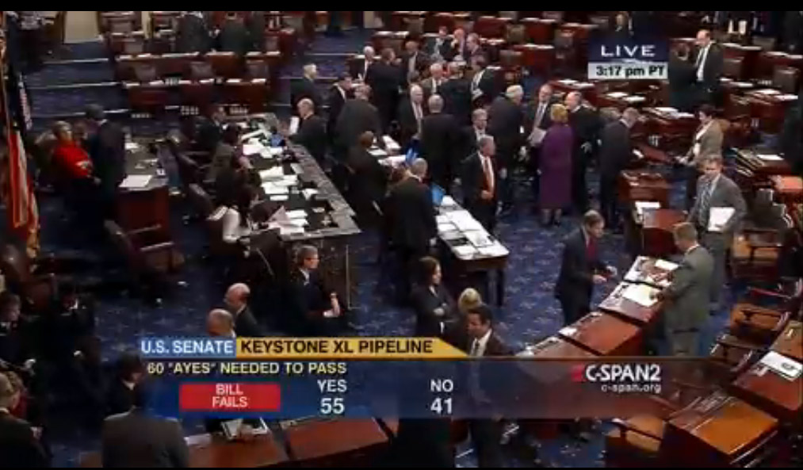
The Bill on the Floor of the Senate-Step 11
  Voting
    Passage of a bill requires a majority vote of all the members present
    If the opposing party tries to filibuster the bill, 60 senators will be needed to pass the bill.
If the bill has been changed, it must be sent back to the House or it is sent to a Conference Committee .

Slide 79
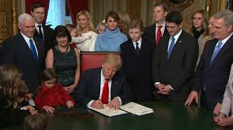
The President Acts-Step 12
  Bill is sent to the President for approval
  The President may sign the bill, and it becomes law
  The President may veto the bill. The measure must then be returned to the house in which it originated, together with the President’s objections. Congress may then pass the bill over the President’s veto, by a two-thirds vote of the full membership of each house
The President may allow the bill to become law without signing it – by not acting on it within 10 days, not counting Sundays, of receiving it.
The fourth option is a variation of the third, called the pocket veto. If Congress adjourns its session within 10 days of submitting a bill to the President and the President does not sign the bill, the measure dies

Slide 80
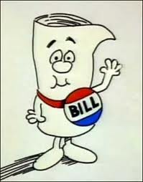
How a Bill Becomes a Law
How a Bill Becomes a Law
Or
How a Bill Becomes a Law

Slide 81
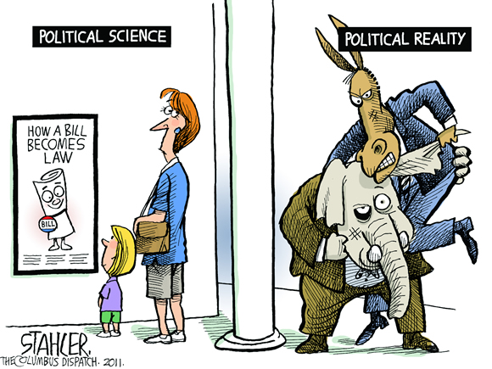
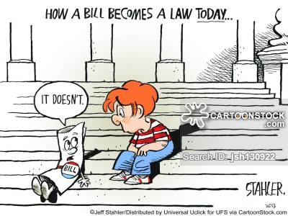
CHAPTER 7 REVIEW QUESTION
Write down and explain 4-5 ideas as to why so few bills become law in the United States.

Slide 82
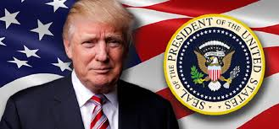
Unit 5 Preview…The Executive Branch

